Slide 1
CSE 391: Programming for the Internet
M. Abdur Rahman

Slide 2
Prerequisite
Join the Moodle course for slides and others.
At least One Programming Language idea
Data structures
OOP
Idea Over XML
Database
Software Engineering
Software Analysis and Design

Slide 3
Acknowledgements
Software Engineering for Web Applications (MIT Open Course Ware)
COMP519: Web Programming (University of Liverpool)
  http://www.csc.liv.ac.uk/~martin/teaching/comp519/
Teach Yourself Ajax in 10 Minutes, Phil Ballard, Sams Publishing, 2006
http://www.w3schools.com

Slide 4
Web ≠ Internet
Internet : a physical network connecting millions of computers using the same protocols for sharing/transmitting information (TCP/IP)
  in reality, the Internet is a network of smaller networks
World Wide Web: a collection of interlinked multimedia documents that are stored on the Internet and accessed using a common protocol (HTTP)
Key distinction: Internet is hardware; Web is software
Many other Internet-based applications exist
e.g., email, telnet, ftp, usenet, Instant Messenger, Torrent, …

Slide 5
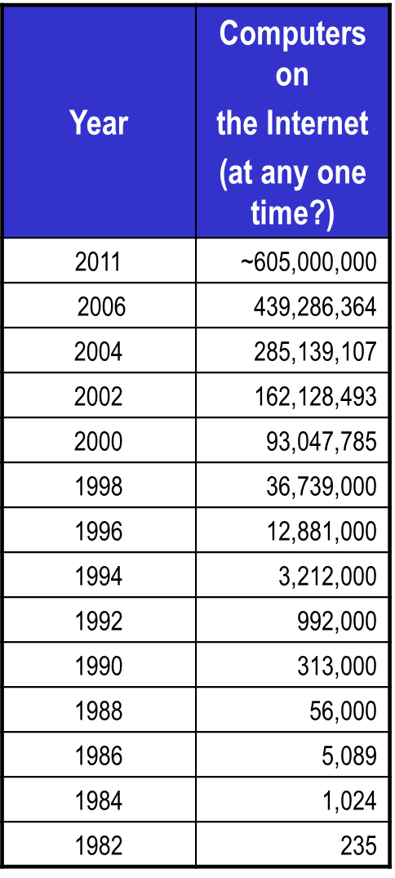
Internet Growth
Internet has exhibited exponential growth,
doubling in size every 1-2 years (stats from Internet Software Consortium)
7,017,846,922 million Internet users in 2012 (approx. 34.3% of world’s population)
(http://www.internetworldstats.com/top20.htm)
Bangladesh Internet Usage and Population Statistics: http://www.internetworldstats.com/asia/bd.htm
YEAR | Users | Population | % Pen.
2000 | 100,000 | 134,824,000 | 0.1 %
2007 | 450,000 | 137,493,990 | 0.3 %
2009 | 556,000 | 156,050,883 | 0.4 %
2010 | 617,300 | 158,065,841 | 0.40%
2011 | 5,501,609 | 158,570,535 | 3.50%
2012 | 8,054,190 | 161,083,804 | 5.0 %

Slide 6
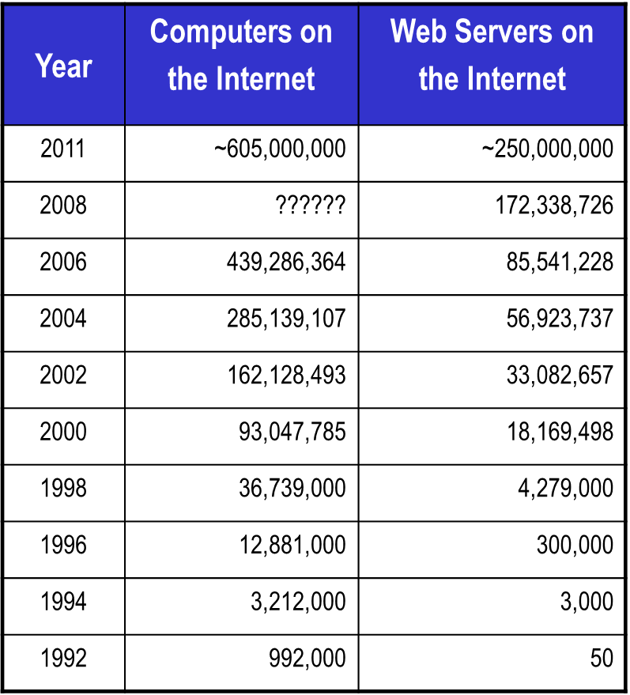
Web Growth
Stats from
Netcraft Web Server Survey.
Google Chrome
Firefox
Safari
IE, Opera
Netscape
Mosaic
A 2012 estimate suggests 30-35 billion Web pages! (Google’s estimated index size is about 30 billion webpages.) (WorldWideWebSize.com)

Slide 7
Basics: Communications Protocols
Old-Style
Program A opens a connection to Computer Program B
Both programs run continuously
This makes it easy for Program B to remember what Program A has said

Slide 8
Basics: Communications Protocols
HTTP: Stateless and Anonymous
HyperText Transfer Protocol (HTTP)
HTTP is stateless

Slide 9
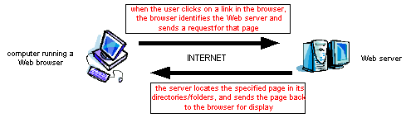
World Wide Web
the Web is the world’s largest client/server system
  communication occurs via message passing
    within browser, select URL of desired page
    browser requests page from server
    server responds with message containing
      type of page (HTML, gif, pdf, zip, …)
      page contents
    browser uses type info to correctly display page
    if page contains other items (images, applets, …),
      browser must request each separately

Slide 10
Server Growth
Feb 2012
Stats from Netcraft Web Server Survey.
http://news.netcraft.com/archives/2012/02/07/february-2012-web-server-survey.html
Developer | Jan-12 | Percent | Feb-12 | Percent | Change
Apache | 378,267,399 | 64.91% | 397,867,089 | 64.92% | 0.01
Microsoft | 84,288,985 | 14.46% | 88,210,995 | 14.39% | -0.07
nginx | 56,087,776 | 9.63% | 60,627,200 | 9.89% | 0.27
Google | 18,936,381 | 3.25% | 19,394,196 | 3.16% | -0.09

Slide 11
Basics: HTTP Concept
Web Page (Client)
Web Browsers
Client-Side Programming
Web Servers (Server)
Server-Side Programming

Slide 12
Basics: anatomy of a typical HTTP session
User types "www.yahoo.com" into a browser
Browser translates www.yahoo.com into an IP address and tries to open a TCP connection with port 80 of that address
Once a connection is established, the browser sends the following byte stream: "GET / HTTP/1.0".
The "GET" means that the browser is requesting a file.
The "/" is the name of the file, in this case simply the root index page.
The "HTTP/1.0" says that this browser would prefer to get a result back adhering to the HTTP 1.0 protocol.
Yahoo responds with a set of headers indicating which protocol is actually being used.
Yahoo sends the contents of its index page
The TCP connection is closed when the file has been received by the browser.

Slide 13
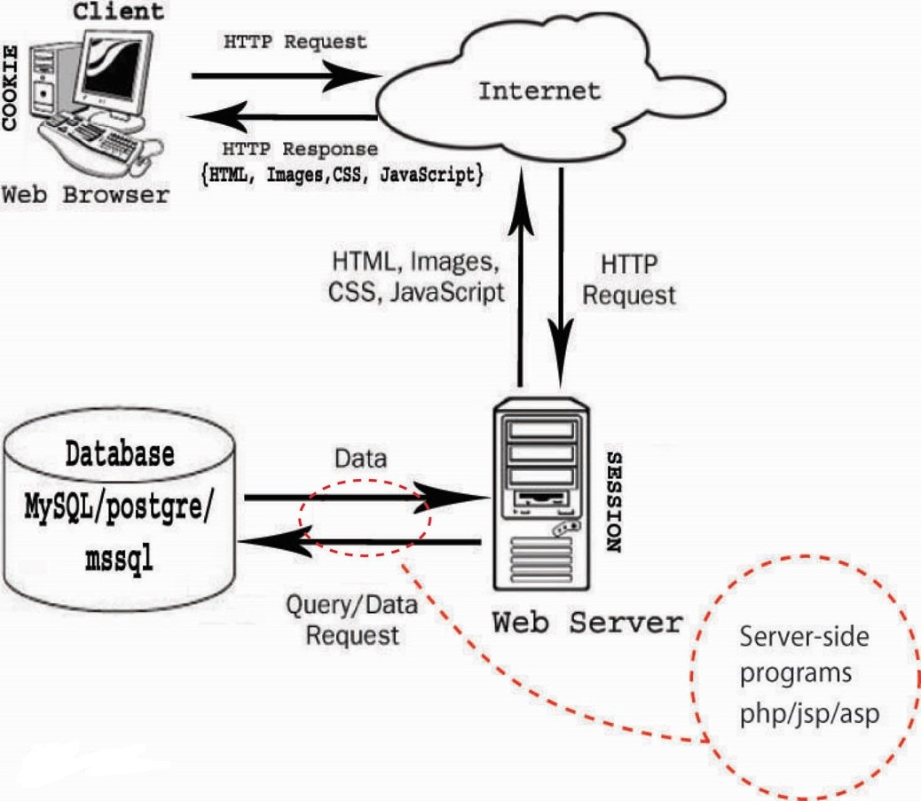
Basics: HTTP Concept

Slide 14
Basics: HTML / CSS / Jscript
Hyper Text Markup Language
View in Client Side
Cascading Style Sheets
Visual Representation property only
Some what Client Side Manipulation with JavaScript

Slide 15
Query?
What class is this again?

